Slide 1
The Battle of Neighborhoods
Manas Ranjan Pradhan
Senior Analyst, Infosys.

Slide 2
Business Problem Statement
An entrepreneur wants to open one business setup in an appropriate area in Mumbai city, India. He has some specific type of business in mind. He has not been able finalized business type yet. Also he is not sure about which area would be suitable for setting his business.

Slide 3
Description
Mumbai is one of the biggest city of India where population is so high. There are lot of business scopes present in the city. On the other hand the market is competitive enough.
For better sustainability of the business, selection of proper business location is crucial. One can not simply open his setup anywhere in the city, which might lead to severe business loss.
If there is a business idea in mind, it is important to know whether that type of business is suitable or falls under an usual trend in the region.

Slide 4
Data Description
From Foursquare location data, gps coordinates for I downloaded using API for entire region.
Category and name column denote the type of business for each of the points of interest. These two columns are used together.
Eg.
Category “New Café coffee shop” represents a business type of “coffee shop”
Name “Great delicious bakery” represents a business type of bakkery.
I filter ed out irrelevant data like ‘building’, ‘space’ etc.
Data extraction may be a heavier process and can not be repeated frequently. We shall save the extracted and processed data in flat files in different steps during our analysis.

Slide 5
Solution
Business Hubs
Locations need to discovered which are Business hubs in Mumbai city.
Using Foursquare location data, points of interests for entire Mumbai can be extracted.
We shall not specify any category while downloading data for points of interest. After downloading this data we can create clusters based on the coordinates of the points.
Clustering
There are various clustering techniques available. Density based algorithm comes to mind. This shall divide the points based on density. Instead we can specify a certain number of clusters by our self. It shall help in dividing the points in more evenly.

Slide 6
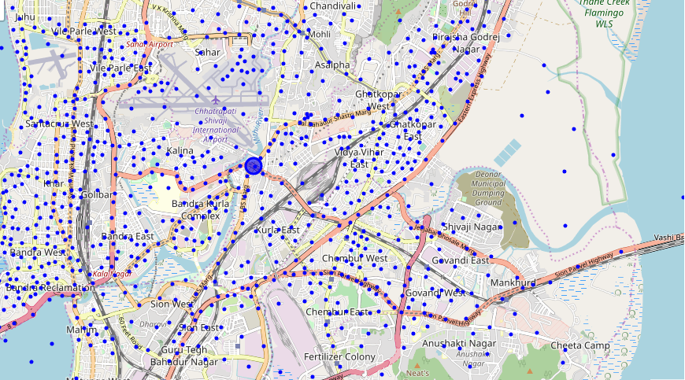
Business Clusters

Slide 7
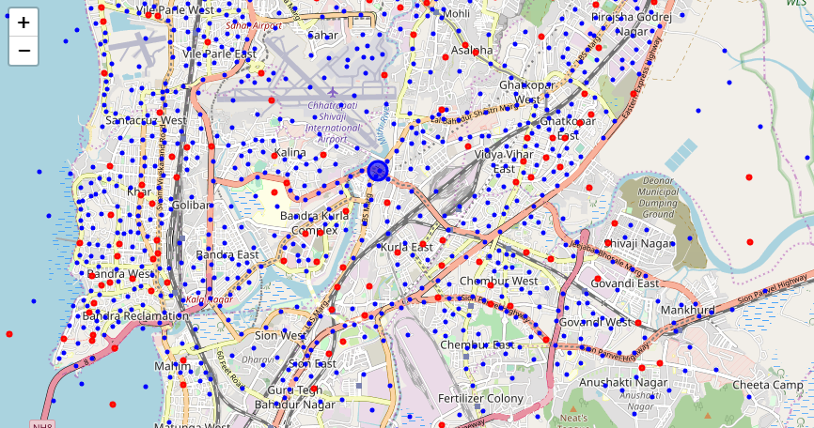
Business Clusters with Dessert shops already

Slide 8
Decision for Location
Locations needs to decided considering following factors
Near by cluster
The business hub or cluster which is nearer to home may be preferred for starting the business.
Cluster not having a type of business
If there are clusters where there are less or no presence of business in my preferred category, those can be suitable.
Commonly found together
As an extended approach, we can analyze the clusters and find with which type of business the preferred category is found together. There might be some unknown benefits of having those businesses nearby. We can check if those are present our preferred cluster.

Slide 9
Thank You

